Slide 1


Serving in the Shadows!
Reverend Anthony Kelley*
Crime Prevention, Prison Ministry and Criminal Justice Training Course
230 PAGE -THIRTEEN MODULE CURRICULUM
“…if any person be overtaken in any trespass…restore him/her in a spirit of gentleness” Galatians: 6:1
*Founder and Former Executive Secretary, Prison Ministry and Criminal Justice Commission, National Baptist Convention, USA, Inc.

Slide 2

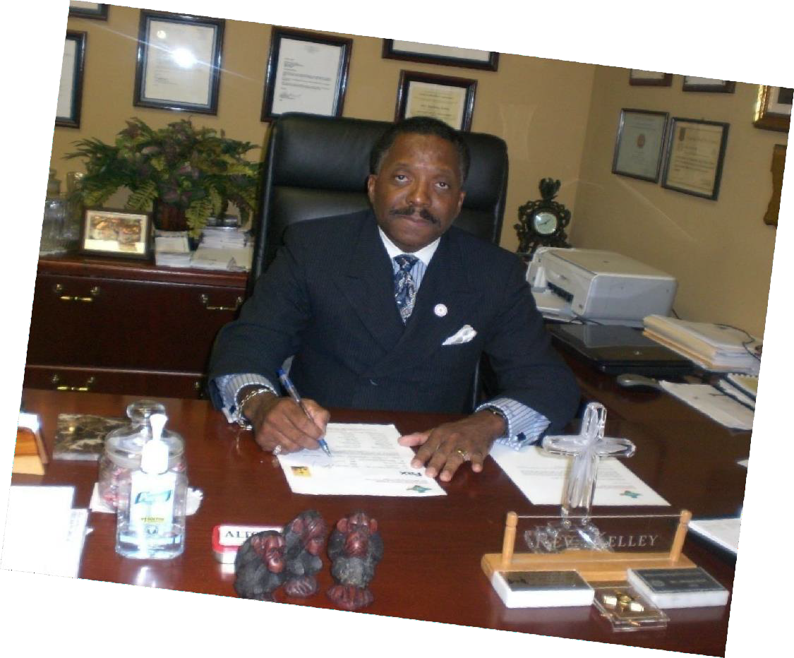

Founder , Chairman and CEO Reverend Anthony Kelley, B.A., M.Div.
Organizer, (Ret.) Pastor and Teacher, Greater First Church Baptist, Baker, (East Baton Rouge Parish), Louisiana
RECLAMATION AND RESTORATION MINISTRIES, INC.
(A 501 © (3) Non-Profit Public Charity)
“…if any person be overtaken in any trespass…restore him/her in a spirit of gentleness” Galatians 6:1
2

Slide 3

MISSION STATEMENT
Reclamation and Restoration Ministries, Inc. (RRM) is a
501 (c) (3) Non-Profit Public Charity that was organized on January 15, 1996 and Incorporated on March 5, 1996. The and
and
purpose of the Corporation is to promote social
community
wholeness
by
actively
developing
implementing
relevant and
life-changing
ministries and
programs
that will prevent and/or deliver
youth and adults
from violence, crime, truancy, drug abuse, homelessness, and
prison and to equip and/or restore them to lead responsible,
meaningful and productive lives.
As a non-profit Public Charity, contributions to RRM, Inc. are deductible under Course 170 of the IRS Code. RRM is qualified also to receive tax deductible
gifts under Course 2055, 2106 or 2522 of the Code.
3

Slide 4
ORGANIZATIONAL, ADMINISTRATIVE
AND FISCAL CAPACITY
FAMILY AND COMMUNITY PRESERVATION PROGRAMS
RECLAMATION AND RESTORATION MINISTRIES, INC. (RRM) is a 501 (c) (3)
Non-Profit Public Charity that was organized on January 15, 1996 and Incorporated on March 5, 1996. The purpose of the Corporation is to promote social and community wholeness by actively developing and implementing relevant and life-changing ministries and programs
that will prevent and/or deliver youth and adults from violence, crime, truancy, drug abuse, homelessness, and prison and to equip and/or restore them to lead responsible, meaningful and productive lives.
Ready4Life Crime Prevention and Family Renewal Partnership Project
Ready4Life Crime and Violence Intervention and Prevention Project
Ready4Life Reinvestment Project for Youth in At-Risk Situations
Ready4Life Ex-prisoner Community Reentry and Recovery Project
Ready4LifeManhood/Fatherhood Training and MentoringProgram
Ready4Life Daughtersof Destiny Female Mentoring Program
Ready4Life Project Village Mentoring Children of Prisoners Initiative
Ready4Life Alcohol and DrugAbuse Awareness and PreventionProgram
RRM organized in Gary, Indiana, and while operating in LakeCounty,
Indiana before relocating its operations to East Baton RougeParish,
Louisiana in 2005, worked successfully for eight (8) years with
thirty-four (34) faith-based, governmental, criminal justice agencies, businesses, and community organizations on a consistent basis.
This collaboration was named the Planning, Evaluationand
Advisory Coalition Entity (P.E.A.C.E). P.E.A.C.E provides general oversight and monitoring and evaluation services for all RRM Projects.
Ready4Life HIV/AIDS RiskReduction and Prevention Program
Anthony Kelley Prison Ministry and Criminal Justice Training Institute
Ready4Life Digital Media and Marketing Arts Acceleration Project
Participation in
Federal Grant Programs
RRM has participated in 8 Federal grant programs to-date through
the USDOJ/OJJDP, USDOL/USDOJ/ANNIE E. CASEY FOUNDATION, and USDHHS/AFC-ACYF.
Financial Management Fiscal Policy
Each grant received by RRM has been executed in accordancewith fiscal policies set forth by RRM Board of Directors to govern the fiscal oversight of the agency’s operations. RRM follows generally accepted accounting principles for all transactions and maintains its fiscal recordsaccording.
3

Slide 5
RRM Organizational Partners 2005-2022
Organizations that comprised the Monthly Planning, Evaluation and Advisory Coalition Entity (P.E.A.C.E.) that supported RRM work and special projects in Lake County, Indiana included: National Association of Blacks in Criminal Justice (NABCJ) ; National Religious Affairs Association, Affiliate of NABCJ; Prison Ministry and Criminal Justice Commission, Affiliate of the National Baptist Convention, USA, Inc.; IN Department of Workforce Development Services; Edgewater Systems for Balanced Living, Inc.; Urban League of Northwest Indiana; Partnership for a Drug Free Lake County; Lake County Coroner’s Office; Superior Court of Lake County Juvenile Division; Lake County Council; Lake County Convention and Visitors Bureau; Interfaith Clergy Council of Gary and Vicinity; Lake County Chaplain’s Association; Lake County Sheriff’s Department; Lake County Office Division of Family and Children; IN Family and Social Services Administration/Division of Mental Health; IN Department of Correction; IN State Police; IN Black State Troopers Assn; Gary Police Department; Gary Drug Free Coalition; Gary City Court; Gary Community School Corporation; Gary Housing Authority; Gary Neighborhood Services; Gary YWCA; Gary Youth Services Bureau; Mayor’s Office City of Gary; Gary-Hammond-East Chicago Empowerment Zone; Serenity House of Gary; Parents Distribution Center of Gary; Geminus Corporation; PSI Family Services; No Bars: Illinois Task Force on Children of Incarcerated Parents and Children of Promise, and the Salvation Army.
Organizational Partners in Louisiana since relocating operations to Baton Rouge in 2005 include: US Attorneys Office for the Middle District of LA; LA Department of Public Safety and Corrections/Adult Services; LA Department of Public Safety and Corrections, Louisiana Office of Juvenile Justice; LA Department of Children and Family Services; EBR Parish Sheriff’s Office; Office of the Mayor- President, City of Baton Rouge/Parish of EBR Workforce Investment Board; Baton Rouge Police Department; Baton Rouge Community College; Pelican Chapter Associated Builders and Contractors; Communities Committed to Reentry; Family Service of Greater BR; BR Area Alcohol and Drug Center; Capitol Area Technical College; Greater First Church Baptist; Mayor’s Office, City of Baker; Housing Authority of EBRP; Habitat for Humanity of Greater Baton Rouge; Black Family Initiative; Ochsner Health, Red River Bank; Living Faith Christian Center; Prison Ministry and Criminal Justice Commission/National Baptist Convention, USA, Inc.; and National Alliance of Faith and Justice, Washington, D.C. (Affiliate National Association of Blacks in Criminal Justice).

Slide 6

Presenter:
Reverend Anthony Kelley, B.A., M.Div.
Founder and Former Executive Secretary
Prison Ministry and Criminal Justice Commission,
National Baptist Convention, USA, Inc. (1994-2011)
Organizer, (Ret.) Pastor and Teacher Greater First Church-Baptist 4669 Groom Road, Baker, Louisiana 70714
Founder, Chairman and CEO, Reclamation and Restoration Ministries, Inc.
Website: www.rrministriesinc.org
Phone 225 916-4455; E:mail: akelleyrev@aol.com
Mailing Address: 8647 Glenfield Drive, Baton Rouge, LA 70809
6

Slide 7
Kelley Biographical Sketch
Anthony Kelley is the Visionary Organizer, (Ret.) Senior Pastor and Teacher of the Greater First Church Baptist in Baker, LA. He received his Bachelor of Arts degree (B.A.) from Trinity College, Deerfield, IL (double majors in Sociology and Biblical Studies), and Master of Divinity degree (M.Div.) from Garrett-Evangelical Theological Seminary/Northwestern University Campus, Evanston, IL (Administration and Social Ethics). He has studied Business Administration at the J.L. Kellogg Graduate School of Management at Northwestern University; African American Literature at the Graduate School of Northwestern University; Sociology at Roosevelt University and Loyola University of Chicago; Social Ethics at Chicago Theological Seminary; and Exegesis of Greek New Testament Studies at Seabury-Western Theological Seminary. He was licensed to preach in 1971 by the Centennial Baptist Church on Chicago’s Southside and ordained in 1978 by the First [Institutional] Baptist Church on Chicago’s Westside. He is the former Senior Pastor of the Mount Zion First Baptist Church in Baton Rouge, LA succeeding Dr. T.J. Jemison, former President of the National Baptist Convention, USA, Inc. He served other churches to include Van Buren Missionary Baptist Church, Gary, IN; Union Baptist Church, Danville, IL; and King of All Nations Baptist Church, Chicago, IL.
He is a former Commissioned County Deputy Sheriff Staff Chaplain for the Marion County Sheriff’s Department, Indianapolis, IN and Lake County Sheriff’s Department, Crown Point, IN; first African American State Prison Staff Chaplain at Indiana State Prison and Out Camps Chaplain for Louisiana State Penitentiary. In 1994, he was appointed the Executive Secretary as Founder of the newly created Prison Ministry and Criminal Justice Commission (PMCJC) of the National Baptist Convention, USA, Inc. until 2012. Also, for 15 years he served as the Instructor on Prison Ministry for the National Baptist Congress of Christian Education and past Lecturer for the Annual December Conference of Christian Educators, CED-SSPB of the NBCUSA. Kelley is past President of the Interdenominational Black Pastor’s Conference of Danville, IL; past Vice-President of Danville, IL Branch of the N.A.A.C.P.; past Chairman of the Finance Committee of Baptist General State Convention of IL; past Instructor and Dean of Wood River Baptist District Association of IL; past Delegate of Illinois Assembly on the Prevention of Alcoholism and Substance Abuse; former member of MLK, Jr. Illinois Holiday Council; past President of Interfaith Clergy Council of Gary and Vicinity; former Chairman of Criminal Justice Sub-Committee to establish the Indiana Commission on the Social Status of Black Males; and former Member of Board of Directors of the Urban League of Northwest Indiana. Kelley has also served as Director of the Social Justice Department, Congress Instructor and Member of the Board of Directors of the Greater Louisiana Baptist Convention, Inc.

Slide 8
Kelley Biographical Sketch-Continued
Kelley is also, Founder, Chairman and CEO of the Reclamation and Restoration Ministries, Inc. (a 501 © (3) Non-Profit Public Charity) which engages in youth development, public safety and family preservation projects. Kelley is author of five books, Jailhouse Religion: The Church’s Mission and Ministry to the Incarcerated-1992; A Strange Silence From the Pulpit: The Prophetic Role of Pastors in Prison Ministry-1998, revised 2000; and How Shall They Hear: Effective Preaching to incarcerated individuals-2013 (Townsend Press, Sunday School Publishing Board, Nashville, TN). What the Spirit is Saying to the Church: A Twenty-First Century Progressive Ministry Vision Plan for the Church-in-the-Black Experience was published by Christian Faith Publishing, Inc., Meadville, PA (2017); and Shadows: Serving with Character, Competence, Commitment and Pride in the Absence of Accolades and Recognition, WestBow Press/Division of Thomas Nelson and Zondervan, Bloomington, IN (2021).
AWARDS TO INCLUDE: Cited for Outstanding Service to the Indianapolis Community by: WBRI American Bible Radio
(The Shirley Herd Show) 1982; THE INDIANAPOLIS STAR Newspaper, 1982; THE MARION COUNTY BANNER
Newspaper, 1981; THE RECORDER Newspaper, 1983 WISH Television Channel 8, “Indy Today” program, 1982; WRTV Television Channel 6, “Living for The City” program, 1982; WTHR Television Channel 13, “A Portrait of a Winner” on the six o’clock news, January 1983; and WRTV Television Channel 6, “Impact Indiana” program, 1983. Also selected as an OUTSTANDING YOUNG MAN OF AMERICA by the OYM of America Association, endorsed by the United States Jaycees (1980); 2000 CITIZEN OF THE YEAR AWARD- Indiana Chapter of the National Association of Social Workers; and 2000 BARBARA LEEK-WESSON HUMANITARIAN PHOENIX AWARD-Edgewater Systems for Balanced Living, Gary, IN. THE ANTHONY KELLEY ENDOWED SCHOLARSHIP was established in 2003 at Garrett-Evangelical
Theological Seminary (Northwestern University Campus) in honor of Anthony Kelley’s then more than 20 years of faithful
and effective ministry since his graduation from seminary in 1980.
OTHER CERTIFICATES AND LICENSES INCLUDE: Honorary Mayor-President City of Baton Rouge-Parish of East Baton Rouge, LA; Board Certification as Clinical Chaplain by the Louisiana Chaplains' Association, Inc. #237, Baton Rouge, LA; Commissioned Police Chaplain for the City of Baker, LA; and Certificates of Training, Pre-Service Regional Academy-Indiana Dept. of Correction-Div. of Staff Development and Training; and Knapps Officer Correctional Training Academy, LA State Prison, Angola, LA, Louisiana Department of Public Safety and Corrections .

Slide 9

Reverend Anthony Kelley
Prison Ministry and Criminal Justice Training Course
“How to Organize and Implement An Effective Crime Prevention, Prison Ministry and Criminal Justice Program in Faith-based Organizations."
“This life is not godliness, but growth in godliness; not health, but healing; not being, but becoming; not rest, but exercise. We are not now what we shall be, but we are on the way; the process is not yet finished, but it has begun; this is not the goal, but it is a road; at present all does not gleam and glitter, but everything is being purified.” – Martin Luther
Peace and Justice,
Reverend Anthony Kelley, B.A., M.Div.
Founder and Former Executive Secretary, Prison Ministry and Criminal Justice Commission,
National Baptist Convention, USA, Inc.
“…if any person be overtaken in any trespass…restore him/her in a spirit of gentleness” Galatians 6:1

Slide 10

REVEREND ANTHONY KELLEY PRISON MINISTRY AND CRIMINAL JUSTICE VIDEO TRAINING COURSE OUTLINE
Module One: Introduction-The What and Why of Prison Ministry!
Module Two : Things You Need to Know About the Crowd
So, You Want to Minister to Incarcerated Persons, their Children and Families
A Sobering Realty and the Urgency of the Now
Mass Incarceration and Racial Disparity in the Criminal Justice System – (Men, Women and Youth Populations, and Life Sentences)
Module Three : Credentials, Volunteer Orientation, Training and Certification
The Making of a Good Prison Ministry and Criminal Justice Practitioner
Genuine in Motivation, Preparation and Response
The Chaplain as Key Player
Proper Entre’ into Correctional Institutions for Ministry Opportunities
The Role of Security in a Correctional Setting
The Role of Discipline
Some Do’s and Don’ts
Dress Code for Volunteers
Security Clearance, Registration and Volunteer Agreement Form

Slide 11
REVEREND ANTHONY KELLEY PRISON MINISTRY AND
CRIMINAL JUSTICE VIDEO TRAINING COURSE OUTLINE
Module Four: Getting Started with the Local Church
Organizational Structure
Job Descriptions and Responsibilities
Prophetic Role of Pastors in Prison Ministry and
Criminal Justice
Module Five: How to Conduct the Worship Service
Behind Prison Walls
The Gathering, Journey, Arrival, Determination at the Gate,
Screening, the Worship Service, Departure, the Road Home,
and Let’s Do it Again!

Slide 12
REVEREND ANTHONY KELLEY PRISON MINISTRY AND
CRIMINAL JUSTICE VIDEO TRAINING COURSE OUTLINE
Module Six: Evidenced-based Programming and Ministry
Models for the Local Church and other Faith-based
Organizations
How to Implement Best Practices/Evidence-based
Standards of Effective Mentoring Programs for
Youth in At-Risk Situations, incarcerated individuals and
Returning Citizens or Formerly Incarcerated Individuals

Slide 13
REVEREND ANTHONY KELLEY PRISON MINISTRY AND
CRIMINAL JUSTICE VIDEO TRAINING COURSE OUTLINE
Module Seven:
Ready4Life Mentoring Project for Out-of-School Youth
Module Eight:
Ready4Life Prisoner Re-entry and Recovery Project

Slide 14
REVEREND ANTHONY KELLEY PRISON MINISTRY AND
CRIMINAL JUSTICE VIDEO TRAINING COURSE OUTLINE
Module Nine:
Effective Collaboration and Approaches
For Mentoring Programs in the Local Church and
Other Faith-based Organizations

Slide 15
REVEREND ANTHONY KELLEY PRISON MINISTRY AND
CRIMINAL JUSTICE VIDEO TRAINING COURSE OUTLINE
Module Ten:
How Shall They Hear?
Effective Preaching to Incarcerated Individuals
Preparation: Things You Need to Know About the Crowd
Urgency of the Now and a Sobering Reality
Knowledge of Prisoner Characteristics
Knowing the Difference between Hearers and Listeners
Awareness of Security Concerns and Impact on
the Preaching Experience
Approaching the Pulpit with Confidence

Slide 16
REVEREND ANTHONY KELLEY PRISON MINISTRY AND
CRIMINAL JUSTICE VIDEO TRAINING COURSE OUTLINE
Module Eleven: How Shall They Hear?
Effective Preaching to Incarcerated Individuals-Two
Presentation: Things You Need to Say to the Crowd
Inclusiveness
Generality
Simplicity
Relevance
Instill Hope
Move to Action to the “Faith Life” which Makes Courage and
Perseverance Possible

Slide 17
REVEREND ANTHONY KELLEY PRISON MINISTRY AND
CRIMINAL JUSTICE VIDEO TRAINING COURSE OUTLINE
Module Twelve: How Shall They Hear?
Effective Preaching to incarcerated individuals-Three
Penetration: Things You Need to Do to the Crowd
Denial, Disappointment and Disillusionment
Ignorance and Unbelief
A Cruel Conspiracy between Suffering and Silence

Slide 18
REVEREND ANTHONY KELLEY PRISON MINISTRY AND
CRIMINAL JUSTICE VIDEO TRAINING COURSE OUTLINE
Module Thirteen: How Shall They Hear?
Effective Preaching to incarcerated individuals-Four
When the Gospel is Faithfully Preached
Clarity of Calling to Preach to incarcerated individuals
Certainty of Commission to Preach to incarcerated individuals
Conviction of Conscience to Preach to incarcerated individuals
Evaluation of Training Course (Evaluation forms to be completed)

Slide 19
Module One: Introduction
The What and Why of Prison Ministry?
Biblical, Theological, and Existential Mandates
So, You want to minister to incarcerated individuals and their children and families?
In General, How Do You View incarcerated individuals?
What Do You Perceive To Be Their Problems,Weaknesses? What Are Their Needs?
How Do You Feel Toward Persons Who Have Committed Harmful and Unlawful Acts?
What Do You Think You Have To Offer In A Ministry to incarcerated individuals,
Ex-incarcerated individuals, Victims of Crime, and Their Families?
Why Are You Personally Interested In Prison Ministry and/or Mentoring Program?

Slide 20
The What and Why of Prison Ministry
When we approach this discussion of why Prison Ministry is important, we must address this question from three perspectives: biblically, theologically, and existentially.
First, biblically.
  The Holy Scriptures make it perfectly clear that a ministry to incarcerated individuals is part and parcel of the mission of the church.
Jesus, himself, makes prison ministry an integral part of his own public ministry and declares it to be a plank in his five-point platform for ministry and timeless model for his followers. In Luke 4:16 ff, Jesus is presented in the synagogue reading from the Scroll of the prophet Isaiah.

Slide 21
The What and Why of Prison Ministry
Second, theologically.
CHRISTIANS believe that no matter how deep humans might fall into sin, ignorance, disbelief, unbelief and even utter rebellion against God, and fellow humans, they can still be redeemed through repentance and faith in our Christ and Savior (Cf., Romans 10:9-10)
This means that there is dignity and worth of every human person, especially since we are ALL made in God’s image and likeness. And because of this, humans may be fallen creatures, but are still wonderful in that we have some God in us! (Genesis 1)
Thus, Prison Ministry seeks to bring the light of hope in dark dungeons of despair as seen in many of our nation’s prisons. Many incarcerated individuals are caught in the cage of complacency and dungeons of despair.
There is a great need for bold, committed and daring believers to meet incarcerated individuals where they are and help them to move from brokenness to wholeness, from indecision to decision, from no direction to a new direction, from desperation and despair to a new destiny of meaningful and purposeful existence.

Slide 22
The What and Why of Prison Ministry
Third, existentially.
The goal of justice is also emphasized in the Lukan text above when Jesus spoke of the need to minister especially to those who are oppressed by a system of injustice towards the poor, dispossessed, disinherited, and disenfranchised.
Thus, prison ministry also acknowledges and addresses the devastating effects that incarceration has on the hearts, minds, and souls of incarcerated individuals imposed by a criminal justice system (CJS) which itself has oftentimes been viewed to be unjust and oppressive.
Prison Ministry also makes one keenly aware of the disproportionate impact that Mass Incarceration has on people of color in particular, and all others in general. The United States is the world's leader in incarceration with 2.2 million people currently in the nation's prisons and jails — a 500% increase over the last forty years.

Slide 23
The What and Why of Prison Ministry
Therefore,
Get better prepared for and engaged in this most significant and meaningful ministry to help spiritually and morally regenerate, reclaim and restore incarcerated individuals to God, their families, and communities to which they will return upon release from custody.
Count it all joy for the opportunity to serve in prisons despite the absence of television cameras, bright lights, pats on the back, certificates of appreciation, thank “you” for your service, and no financial compensation for their service.
That is the nature of ―ministering in the Shadows, --- i.e., serving with character, competence, commitment, and pride in the absence of accolades and recognition. (See book, titled SHADOWS with the same title as above).
You are charged to become one the many courageous and competent volunteers, pastors, ministers, and Christian workers who have embraced Christ’s mandate to minister to inmates in jails and incarcerated individuals in prisons within their communities and around the nation.

Slide 24
The What and Why of Prison Ministry
What then?
Many Christian volunteers and pastors who participate in prison ministry events will be converted from ignorance and fear and transformed in terms of their own personal attitudes and prejudices about ministering in jails and prisons.
Many will become avid supporters and promoters for other pastors and teachers to engage in this life-liberating work. But only the faithful few are willing to serve in the Shadows. This must be an on-going objective. Otherwise, the beat goes on!
It is without doubt that ministry in jails and prisons will make a tremendous impact on one’s understanding of the Mission of the Church and Christian Ministries to the disappointed, disconnected, disenfranchised, disinherited, and dispossessed. Such a dedicated and sacrificial ministry to incarcerated individuals will truly teach one the value and meaning of ministering in the Shadows of greatness.

